Slide 1
Node.js + MySQL
Aayush Goel
Divyanshu
Abhisar

Slide 2
Node.Js
Node.js is an open-source and cross-platform JavaScript runtime environment. It is a popular tool for almost any kind of project!
Node.js runs the V8 JavaScript engine, the core of Google Chrome, outside of the browser. This allows Node.js to be very performant.
A Node.js app runs in a single process, without creating a new thread for every request. Node.js provides a set of asynchronous I/O primitives in its standard library that prevent JavaScript code from blocking and generally, libraries in Node.js are written using non-blocking paradigms, making blocking behavior the exception rather than the norm.

Slide 3
Why Node.js is preferred
Here is how PHP or ASP handles a file request:
Sends the task to the computer's file system.
Waits while the file system opens and reads the file.
Returns the content to the client.
Ready to handle the next request.
Here is how Node.js handles a file request:
Sends the task to the computer's file system.
Ready to handle the next request.
When the file system has opened and read the file, the server returns the content to the client.
Node.js eliminates the waiting, and simply continues with the next request.
Node.js runs single-threaded, non-blocking, asynchronous programming, which is very memory efficient.

Slide 4
ExpressJS
ExpressJS is a web application framework that provides you with a simple API to build websites, web apps and back ends. With ExpressJS, you need not worry about low level protocols, processes, etc.
Express provides a minimal interface to build our applications. It provides us the tools that are required to build our app. It is flexible as there are numerous modules available on npm, which can be directly plugged into Express.
Express was developed by TJ Holowaychuk and is maintained by the Node.js foundation and numerous open source contributors.
Why Express?
Unlike its competitors like Rails and Django, which have an opinionated way of building applications, Express has no "best way" to do something. It is very flexible and pluggable.

Slide 5
ExpressJS and Mongoose
MongoDB and Mongoose
MongoDB is an open-source, document database designed for ease of development and scaling. This database is also used to store data.
Mongoose is a client API for node.js which makes it easy to access our database from our Express application.

Slide 6
Node.Js + MySSQL
Node.js can be used in database applications.
One of the most popular databases is MySQL.
To be able to experiment with the code examples, you should have MySQL installed on your computer.
To be able to access a MySQL database with Node.js, you need a MySQL driver :
C:\Users\Your Name>npm install mysql
Node.js can use this module to manipulate the MySQL database:
var mysql = require('mysql’);

Slide 7
Creating Connection
Start by creating a connection to the database.
Use the username and password from your MySQL database.
var mysql = require('mysql'); var con = mysql.createConnection({ host: "localhost", user: "yourusername", password: "yourpassword" }); con.connect(function(err) { if (err) throw err; console.log("Connected!"); });

Slide 8
Query to a Database
Use SQL statements to read from (or write to) a MySQL database. This is also called "to query" the database.
The connection object created in the example above, has a method for querying the database:
con.connect(function(err) { if (err) throw err; console.log("Connected!"); con.query(sql, function (err, result) { if (err) throw err; console.log("Result: " + result); }); });

Slide 9
Create database
var mysql = require('mysql'); var con = mysql.createConnection({ host: "localhost", user: "yourusername", password: "yourpassword" }); con.connect(function(err) { if (err) throw err; console.log("Connected!"); con.query("CREATE DATABASE mydb", function (err, result) { if (err) throw err; console.log("Database created"); }); });

Slide 10
Create table
var mysql = require('mysql');
var con = mysql.createConnection({
host: "localhost",
user: "yourusername",
password: "yourpassword",
database: "mydb"
});
con.connect(function(err) {
if (err) throw err;
console.log("Connected!");
var sql = "CREATE TABLE customers (name VARCHAR(255), address VARCHAR(255))";
con.query(sql, function (err, result) {
if (err) throw err;
console.log("Table created");
});
});

Slide 11
Inserting records
var mysql = require('mysql');
var con = mysql.createConnection({
host: "localhost",
user: "yourusername",
password: "yourpassword",
database: "mydb"
});
con.connect(function(err) {
if (err) throw err;
console.log("Connected!");
var sql = "INSERT INTO customers (name, address) VALUES ('Company Inc', 'Highway 37')";
con.query(sql, function (err, result) {
if (err) throw err;
console.log("1 record inserted");
});
});

Slide 12
Select from table
var mysql = require('mysql');
var con = mysql.createConnection({
host: "localhost",
user: "yourusername",
password: "yourpassword",
database: "mydb"
});
con.connect(function(err) {
if (err) throw err;
con.query("SELECT * FROM customers", function (err, result, fields) {
if (err) throw err;
console.log(result);
});
});

Slide 13
Using where filter
var mysql = require('mysql');
var con = mysql.createConnection({
host: "localhost",
user: "yourusername",
password: "yourpassword",
database: "mydb"
});
con.connect(function(err) {
if (err) throw err;
con.query("SELECT * FROM customers WHERE address = 'Park Lane 38'", function (err, result) {
if (err) throw err;
console.log(result);
});
});

Slide 14
Using order by
var mysql = require('mysql');
var con = mysql.createConnection({
host: "localhost",
user: "yourusername",
password: "yourpassword",
database: "mydb"
});
con.connect(function(err) {
if (err) throw err;
con.query("SELECT * FROM customers ORDER BY name", function (err, result) {
if (err) throw err;
console.log(result);
});
});

Slide 15
Delete a table
var mysql = require('mysql');
var con = mysql.createConnection({
host: "localhost",
user: "yourusername",
password: "yourpassword",
database: "mydb"
});
con.connect(function(err) {
if (err) throw err;
var sql = "DROP TABLE customers";
con.query(sql, function (err, result) {
if (err) throw err;
console.log("Table deleted");
});
});

Slide 16
Update table
var mysql = require('mysql');
var con = mysql.createConnection({
host: "localhost",
user: "yourusername",
password: "yourpassword",
database: "mydb"
});
con.connect(function(err) {
if (err) throw err;
var sql = "UPDATE customers SET address = 'Canyon 123' WHERE address = 'Valley 345'";
con.query(sql, function (err, result) {
if (err) throw err;
console.log(result.affectedRows + " record(s) updated");
});
});

Slide 17
Limiting the result
var mysql = require('mysql');
var con = mysql.createConnection({
host: "localhost",
user: "yourusername",
password: "yourpassword",
database: "mydb"
});
con.connect(function(err) {
if (err) throw err;
var sql = "SELECT * FROM customers LIMIT 5";
con.query(sql, function (err, result) {
if (err) throw err;
console.log(result);
});
});

Slide 18
MySQL Joins
var mysql = require('mysql');
var con = mysql.createConnection({
host: "localhost",
user: "yourusername",
password: "yourpassword",
database: "mydb"
});
con.connect(function(err) {
if (err) throw err;
var sql = "SELECT users.name AS user, products.name AS favorite FROM users JOIN products ON users.favorite_product = products.id";
con.query(sql, function (err, result) {
if (err) throw err;
console.log(result);
});
});

Slide 19
A small program to take SQL query from user from command line and execute using Node.Js

Slide 20
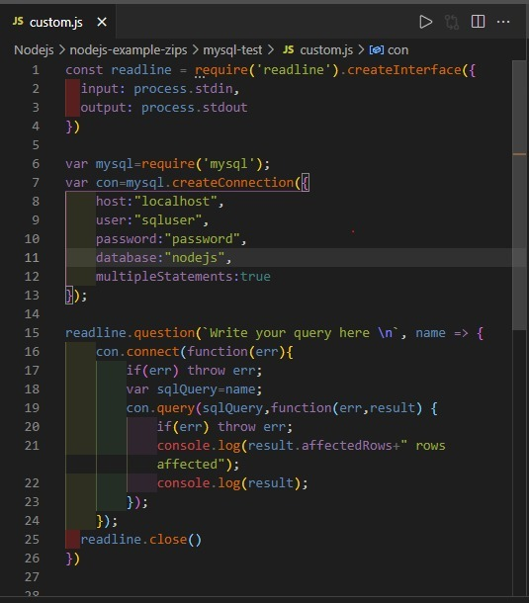

Slide 21
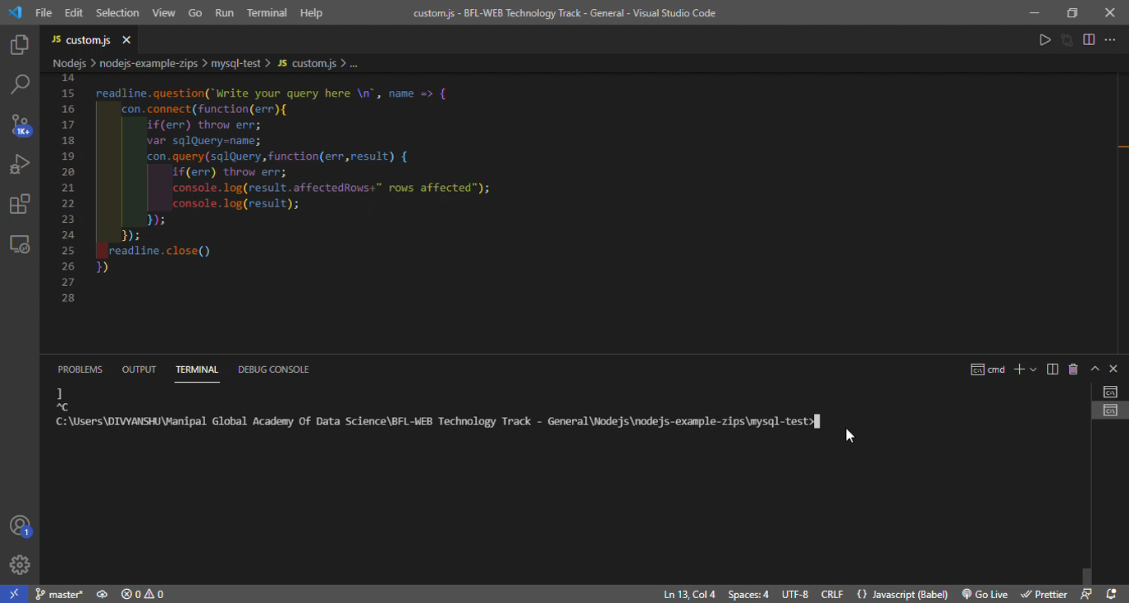

Slide 22
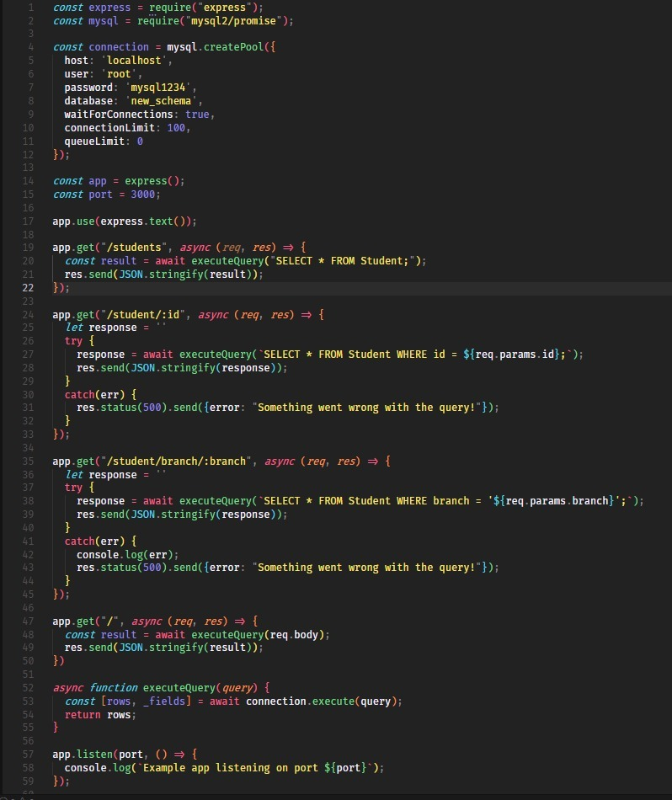
ExpressJS Implementation

Slide 24
Thank you

